Slide 1
Web Dev 4: Front End Web Development
Code Labs
Rami Sayar - @ramisayar
Technical Evangelist

Slide 2
Welcome to Code Labs
Minimal slides
Lots of hands on coding
Don’t worry if you don’t finish
(code and docs are public)
Sessions are filmed after Build
Get help from a proctor if you’re stuck!

Slide 3
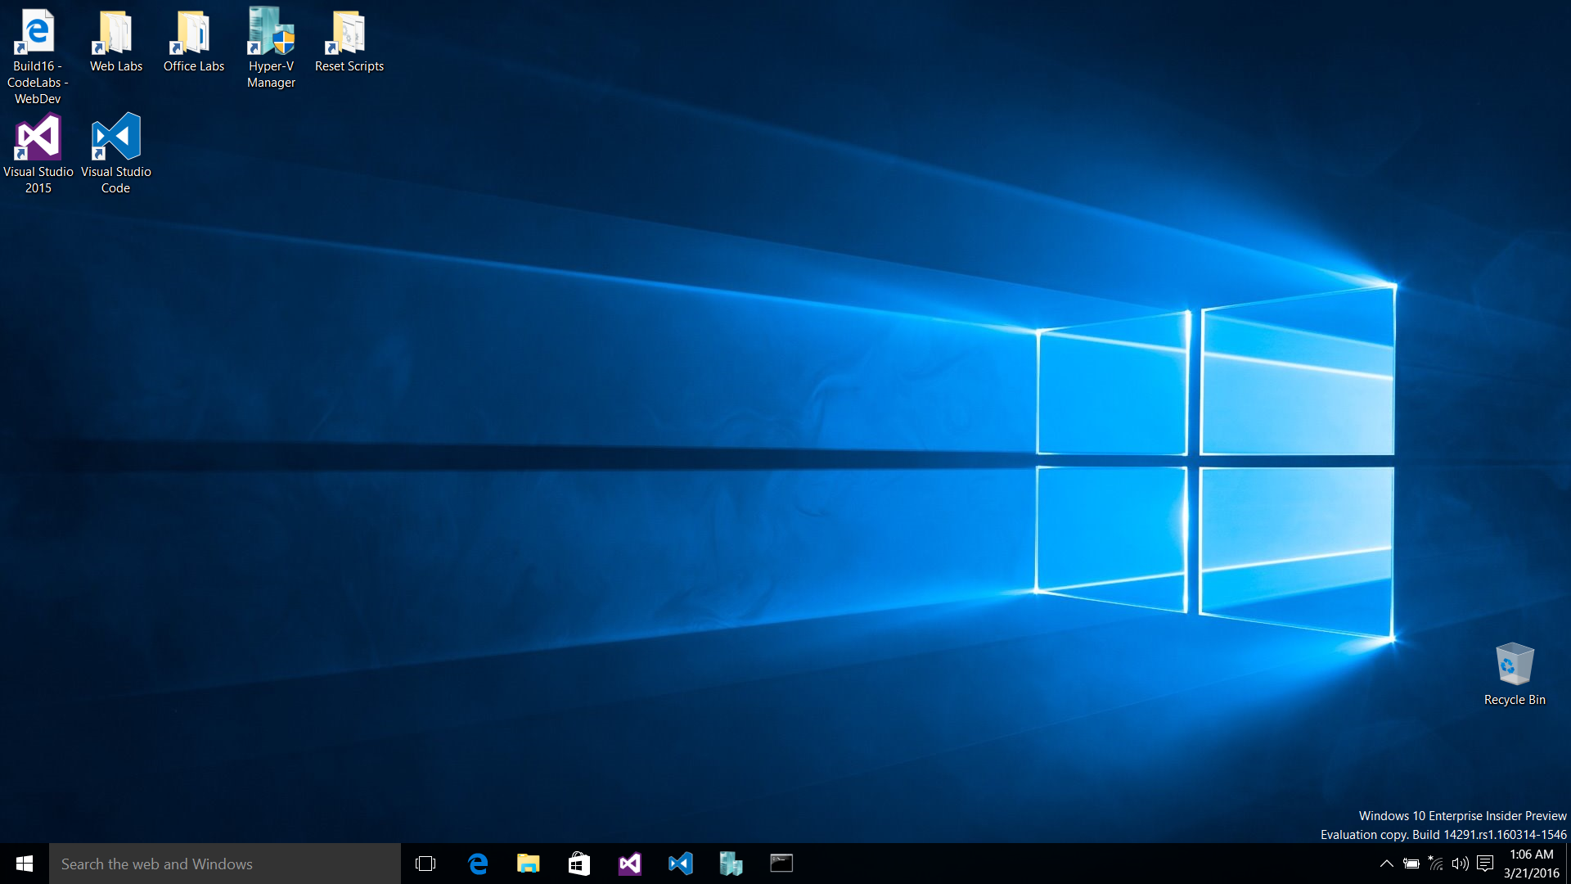

Slide 4
Code Labs: Web Dev track
Module 1 – Intro to ASP.NET Core
Module 2 – ASP.NET Core 1.0 Internals
Module 3 – Deployment and Azure w/ ASP.NET Core
Module 4 – Front End Web Development
Best if you do them in order, but not required

Slide 5
Module 4: Front End Development
Creating an Angular 2 application
Exploring a more advanced Angular 2 application in an ASP.NET Core application
Integrating with ASP.NET Core API controller
Developing for Web Standards with Edge and Vorlon.js
Packaging SPA as an installable App using ManifoldJS

Slide 6
Exercise 1: Creating an Angular 2 App
Task 1 - Introducing the Angular 2 Documentation
Task 2 - Exploring the Angular 2 Quickstart
Notes:
Time: TBD

Slide 7
Exercise 2: A more advanced Angular 2 application
Task 1 - Exploring the Application
Task 2 - Running the Solution
Notes:
Time: TBD

Slide 8
Exercise 3: Integrating an ASP.NET Core API controller
Task 1 - Creating an ASP.NET Core API controller
Task 2 - Integrating the front end with the API controller
Task 3 - Running the Solution
Notes:
Time: TBD

Slide 9
Exercise 4: Web Standards with Edge and Vorlon.js
Task 1 - Using the Vorlon.js Extension
Task 2 - Using the Vorlong.js Server
Notes:
Time: TBD

Slide 10
Exercise 5: Packaging SPA using ManifoldJS
Task 1 - Creating a Hosted Web Application with ManifoldJS
Task 2 - Adding toast and live tiles to your Hosted Web Application
Notes:
Time: TBD

Slide 11
Wrap-up
Notes:
Do this in the last 5 minutes of the event

Slide 12
Web Dev Code Lab Related Sessions Wednesday 03/30
11:30 – 12:30
14:00 – 15:00 | Microsoft Edge: What's Next for Microsoft's New Browser and Web Platform Moscone 2001
15:30 – 16:30 | What’s New in Typescript Marriott 9
17:00 – 18:00

Slide 13
Web Dev Code Lab Related Sessions Thursday 03/31
11:30 – 12:30
14:00 – 15:00
15:30 – 16:30 | Web Apps Across Windows Devices Moscone 2005
17:00 – 18:00 | ASP.NET Core 1.0 Marriott 9
18:30 – 19:30

Slide 14
Web Dev Code Lab Related Sessions Friday 04/01
09:00 – 10:00 | Entity Framework Core 1.0 Marriott 8
10:30 – 11:30 | Deploying ASP.NET Core Apps Moscone 2001
12:30 – 13:30 | ASP.NET Core: MVC Deep Dive Marriott 9 | Web Platform: An Inside Look at What’s New for Microsoft EdgeHTML, ChakraCore, F12 Tools, and Microsoft Edge Extensions Moscone 2001
14:00 – 15:00

Slide 15
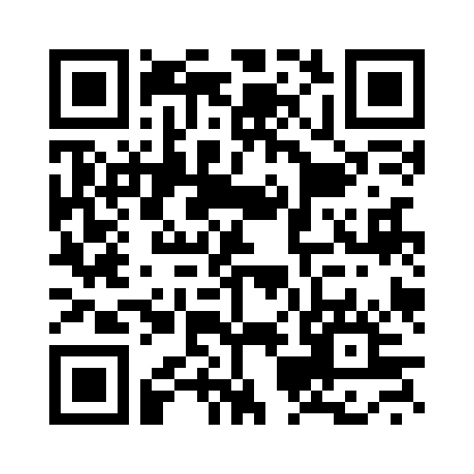
REVIEW THIS SESSION

